Slide 1



Zomato Analysis SQL Project Group 4

Slide 2
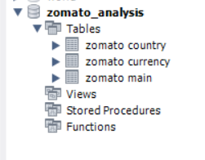
1st KPI Build a data model using the excel sheets.
Query
CREATE TABLE Zomato_Analysis.Zomata Main
(
RestaurantID INT,
RestaurantName VARCHAR(255),
CountryCode INT,
City VARCHAR(255),
Address VARCHAR(255),
Locality VARCHAR(255),
LocalityVerbose VARCHAR(255),
Longitude FLOAT,
Latitude FLOAT,
Cuisines VARCHAR(255),
Currency VARCHAR(50),
Has_Table_booking VARCHAR(3),
Has_Online_delivery VARCHAR(3),
Is_delivering_now VARCHAR(3),
Switch_to_order_menu VARCHAR(3),
Price_range INT,
Votes INT,
Average_Cost_for_two INT,
Rating FLOAT,
Year_Opening INT,
Month_Opening INT,
Day_Opening INT
);
Data Import from CSV for
Zomato Country table and
Zomato Currency table
Result Grid.

Slide 3
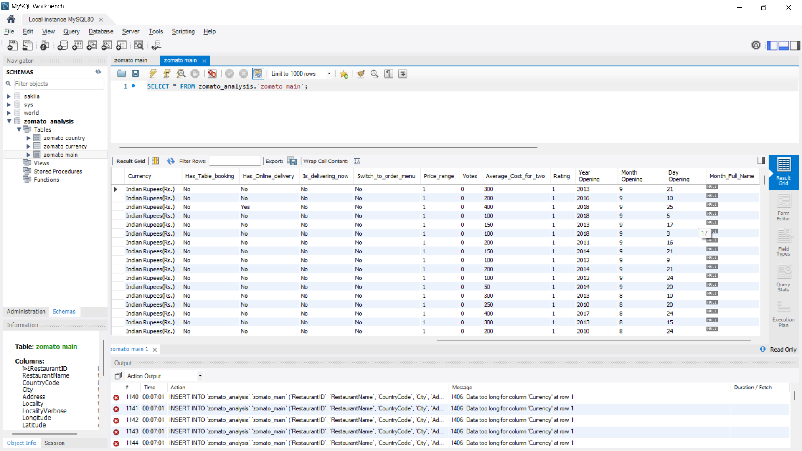
2^{nd(A)} KPI Build a data a calendar using the date keys
Query
CREATE TABLE Zomato_Analysis.Zomata Main
(
RestaurantID INT,
RestaurantName VARCHAR(255),
CountryCode INT,
City VARCHAR(255),
Address VARCHAR(255),
Locality VARCHAR(255),
LocalityVerbose VARCHAR(255),
Longitude FLOAT,
Latitude FLOAT,
Cuisines VARCHAR(255),
Currency VARCHAR(50),
Has_Table_booking VARCHAR(3),
Has_Online_delivery VARCHAR(3),
Is_delivering_now VARCHAR(3),
Switch_to_order_menu VARCHAR(3),
Price_range INT,
Votes INT,
Average_Cost_for_two INT,
Rating FLOAT,
Year_Opening INT,
Month_Opening INT,
Day_Opening INT
);
Result Grid

Slide 4
2^{nd(B)} KPI Add Year, Month, and Month Full name.
Query 1
CREATE TABLE Zomato_Analysis.Zomata Main
(
RestaurantID INT,
RestaurantName VARCHAR(255),
CountryCode INT,
City VARCHAR(255),
Address VARCHAR(255),
Locality VARCHAR(255),
LocalityVerbose VARCHAR(255),
Longitude FLOAT,
Latitude FLOAT,
Cuisines VARCHAR(255),
Currency VARCHAR(50),
Has_Table_booking VARCHAR(3),
Has_Online_delivery VARCHAR(3),
Is_delivering_now VARCHAR(3),
Switch_to_order_menu VARCHAR(3),
Price_range INT,
Votes INT,
Average_Cost_for_two INT,
Rating FLOAT,
Year_Opening INT,
Month_Opening INT,
Day_Opening INT
);
Query 2
ALTER TABLE Zomato_Analysis.Zomata Main ADD COLUMN Month_Full_Name VARCHAR(20);
Result Grid

Slide 5
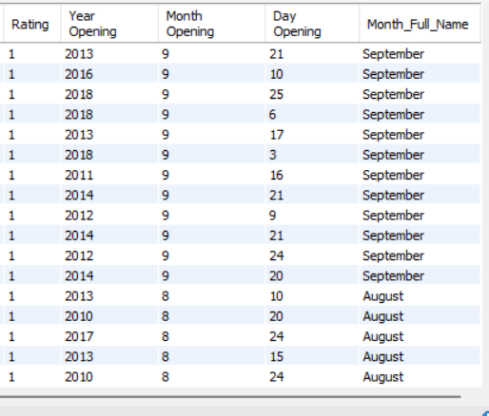
2^{nd(C)} KPI Adding Month Names
Query
UPDATE Zomato_Analysis.Zomata Main
SET Month_Full_Name = CASE
WHEN Month_Opening = 1 THEN 'January'
WHEN Month_Opening = 2 THEN 'February'
WHEN Month_Opening = 3 THEN 'March'
WHEN Month_Opening = 4 THEN 'April'
WHEN Month_Opening = 5 THEN 'May'
WHEN Month_Opening = 6 THEN 'June'
WHEN Month_Opening = 7 THEN 'July'
WHEN Month_Opening = 8 THEN 'August'
WHEN Month_Opening = 9 THEN 'September'
WHEN Month_Opening = 10 THEN 'October'
WHEN Month_Opening = 11 THEN 'November'
WHEN Month_Opening = 12 THEN 'December'
ELSE 'Unknown'
END;
Result Grid

Slide 6
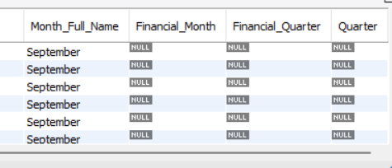
2^{nd(D)} KPI Creating columns Financial Month, Financial Quarter & Quarter
Query
ALTER TABLE Zomato_Analysis.Zomata Main
ADD COLUMN Financial_Month VARCHAR(20),
ADD COLUMN Financial_Quarter VARCHAR(20),
ADD COLUMN Quarter VARCHAR(20);
Result Grid

Slide 7
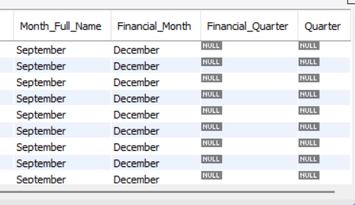
2^{nd(Ea)} KPI Inserting Data into Financial Month Column
Query
UPDATE Zomato_Analysis.Zomata Main
SET Financial_Month = CASE
WHEN Month_Opening = 1 THEN 'April'
WHEN Month_Opening = 2 THEN 'May'
WHEN Month_Opening = 3 THEN 'June'
WHEN Month_Opening = 4 THEN 'July'
WHEN Month_Opening = 5 THEN 'August'
WHEN Month_Opening = 6 THEN 'September'
WHEN Month_Opening = 7 THEN 'October'
WHEN Month_Opening = 8 THEN 'November'
WHEN Month_Opening = 9 THEN 'December'
WHEN Month_Opening = 10 THEN 'January'
WHEN Month_Opening = 11 THEN 'February'
WHEN Month_Opening = 12 THEN 'March'
ELSE 'Unknown'
END;
Result Grid

Slide 8
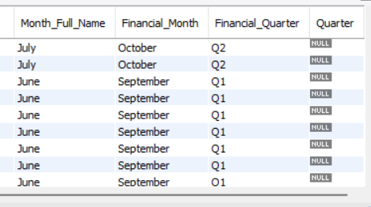
2^{nd(Eb)} KPI Inserting Data into Financial Quarter Column
Query
UPDATE Zomato_Analysis.Zomata Main
SET Financial_Quarter = CASE
WHEN Month_Full_Name IN ('April', 'May', 'June') THEN 'Q1'
WHEN Month_Full_Name IN ('July', 'August', 'September') THEN 'Q2'
WHEN Month_Full_Name IN ('October', 'November', 'December') THEN 'Q3'
WHEN Month_Full_Name IN ('January', 'February', 'March') THEN 'Q4'
ELSE 'Unknown'
END;
Result Grid

Slide 9
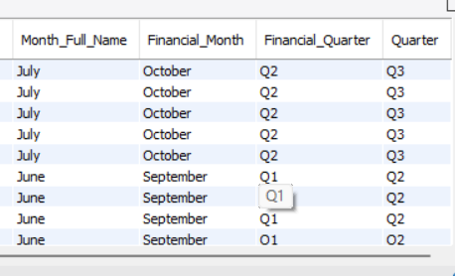
2^{nd(Ec)} KPI Inserting Data into Quarter Column
Query
UPDATE Zomato_Analysis.Zomata Main
SET Quarter = CASE
WHEN Month_Full_Name IN ('January', 'February', 'March') THEN 'Q1'
WHEN Month_Full_Name IN ('April', 'May', 'June') THEN 'Q2'
WHEN Month_Full_Name IN ('July', 'August', 'September') THEN 'Q3'
WHEN Month_Full_Name IN ('October', 'November', 'December') THEN 'Q4'
ELSE 'Unknown'
END;
Result Grid

Slide 10
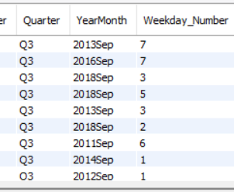
2^{nd(F)} KPI Adding and inserting into Week Day Number Column
Query
Adding Column Weekday_Number
ALTER TABLE zomato_analysis.`zomato main`
ADD COLUMN Weekday_Number INT;
Updating the column
UPDATE zomato_analysis.`zomato main`
SET Opening_Date = STR_TO_DATE(CONCAT(`Year Opening`, '-', `Month Opening`, '-', `Day Opening`), '%Y-%c-%e’);
UPDATE zomato_analysis.`zomato main`SET Weekday_Number = DAYOFWEEK(Opening_Date);
Result Grid

Slide 11
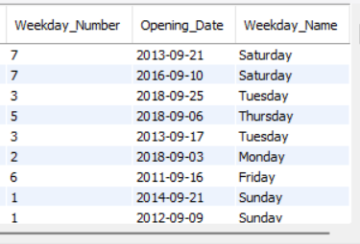
2^{nd(G)} KPI Adding and inserting into Week Day Name Column
Query
Adding Column Weekday_Name
ALTER TABLE zomato_analysis.`zomato main`
ADD COLUMN Weekday_Name INT;
Updating the column
UPDATE zomato_analysis.`zomato main`
SET Opening_Date = STR_TO_DATE(CONCAT(`Year Opening`, '-', `Month Opening`, '-', `Day Opening`), '%Y-%c-%e’);
UPDATE zomato_analysis.`zomato main`
SET Weekday_Name = DATE_FORMAT(Opening_Date, '%W');
Result Grid

Slide 12
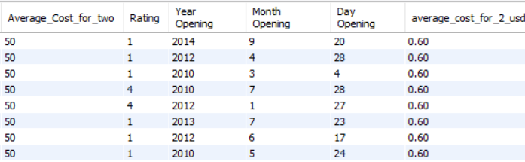
3rd KPI Convert the Average cost for 2 column into USD dollars
Query
ALTER TABLE zomato
ADD COLUMN average_cost_for_2_usd DECIMAL(10, 2);
update zomato
SET average_cost_for_2_usd = average_cost_for_two * 0.012;
select * from zomato;
Result Grid

Slide 13
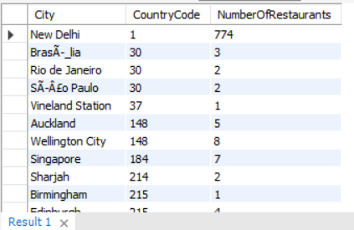
4th KPI Number of restaurants based on city and country
Query
SELECT City,
CountryCode,
COUNT(*) AS NumberOfRestaurants
FROM zomato_analysis.`zomato main`
GROUP BY City, CountryCode
ORDER BY CountryCode, City;
Result Grid

Slide 14
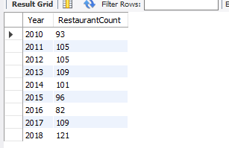
5^{th(A)} KPI Numbers of Restaurants opening based on Year
Query
select Year, count(*) as RestaurantCount
from zomato
group by Year
order by Year;
Result Grid

Slide 15
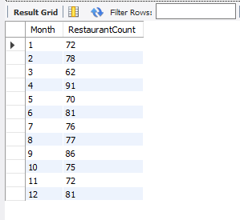
5^{th(B)} KPI Numbers of Restaurants opening based on Month
Query
select Month, count(*) as RestaurantCount
from zomato
group by Month
order by Month;
Result Grid

Slide 16
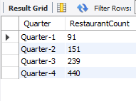
5^{th(C)} KPI Numbers of Restaurants opening based on Quarters
Query
select Quarter, count(*) as RestaurantCount
from zomato
where Quarter is NOT NULL
group by Quarter
order by Quarter;
Result Grid

Slide 17
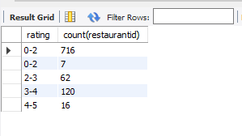
6th KPI Count of Restaurants based on Average Ratings
Query
select case when rating <=2 then
"0-2" when
rating <=3 then "2-3" when rating <=4 then "3-4" when Rating<=5 then "4-5" end rating,
count(restaurantid)
from zomato
group by rating
order by rating;
Result Grid

Slide 18
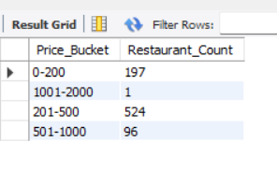
7th KPI Create buckets based on Average Price of reasonable size and find out how many restaurants falls in each buckets
select * from zomato;
SELECT
CASE
WHEN Average_Cost_for_two < 200 THEN '0-200'
WHEN Average_Cost_for_two BETWEEN 200 AND 500 THEN '201-500'
WHEN Average_Cost_for_two BETWEEN 501 AND 1000 THEN '501-1000'
WHEN Average_Cost_for_two BETWEEN 1001 AND 2000 THEN '1001-2000'
WHEN Average_Cost_for_two BETWEEN 2001 AND 5000 THEN '2001-5000'
ELSE '5001+'
END AS Price_Bucket,
COUNT(*) AS Restaurant_Count
FROM
zomato
GROUP BY
Price_Bucket
ORDER BY
Price_Bucket;
Result Grid

Slide 19
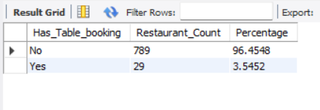
8th KPI Percentage of Restaurants based on "Has_Table_booking"
Query
SELECT
Has_Table_booking,
COUNT(*) AS Restaurant_Count,
(COUNT(*) / (SELECT COUNT(*) FROM zomato) * 100) AS Percentage
FROM
zomato
GROUP BY
Has_Table_booking;
Result Grid

Slide 20
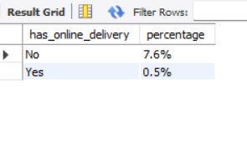
9th KPI Percentage of Restaurants based on "Has_Online_delivery"
Query
select has_online_delivery,
concat(round(count(Has_Online_delivery)/100,1),"%")
percentage
from Zomato
group by has_online_delivery;
Result Grid

